Slide 1
Behavioral Explorations: Profiling from Spotify Data
Kenzi Lamberto (1654201)
Supervised by Amanda Belton and Daniel

Slide 2
SPOTIFY
UNWRAPPED
Stage 2
Aggregation and visualisation
Stage 3
Augment with sensemaking data
Spotify
Data
Interview
Data
We are here
Mediaflux
Stage 1
Researcher
Spotify
Data
Participant
Collection
Donated data merged into db
Transcribe
Local data
MRC Server
Researcher
Collect
Spotify data
Viz
Extract
Data returned as viz for sensemaking before interview
Participant
Mediaflux
Stage 4
Viz
Viz
Analysis and dissemination
Stakeholder
Extract
Data store
Analyse
Data flow
Researchers
name
Sharable data
Disseminate
Interview
Data
Spotify
Data
Name
Activity

Slide 3
Three behaviour profiles desired:
Receptive
Receptive users use algorithmic affordances like the AI DJ, autogenerated playlists, and platform recommendations. Their data indicates low-effort discovery.
They frequently use the personalised mixes and show high trust in the curation of their listening experience by the platform.
The left
Low-friction lean-back
Responsive
Responsive and flexible users who actively search for new music, use shuffle frequently, skip tracks, and frequently update their playlists.
They are less trusting of the algorithmic recommendations than others but also more frequently active in curating their listening experience. (Does this extend to using playlists of other users?)
The middle
High-activity adjustment
Deliberate
Deliberate users who rely on their library and fixed ordering (album or playlist order) to create intentional listening sessions.
They rarely shuffle or skip songs and invest time in crafting their listening experience with the least trust in the algorithmic experience.
The right
Goal-oriented listening

Slide 4
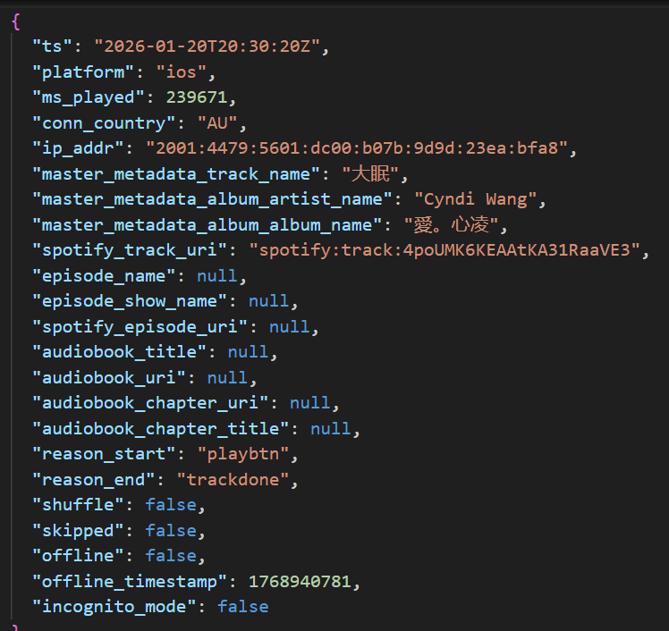
New Direction: Raw Streaming History Inputs
How to use the following data to categorise three behaviour profiles desired?
Reason why the track started
Reason why the track ended
Was the track played during shuffle mode?
Was the track skipped?

Slide 5
New Direction: Raw Streaming History Inputs
From research
Skip: within 5 seconds of listening, active filtering
Shuffle: in-between control and chance, exploratory intent
References:
The skipping behavior of users of music streaming services and its relation to musical structure - PMC
Do the shuffle: Exploring reasons for music listening through shuffled play - PMC

Slide 6
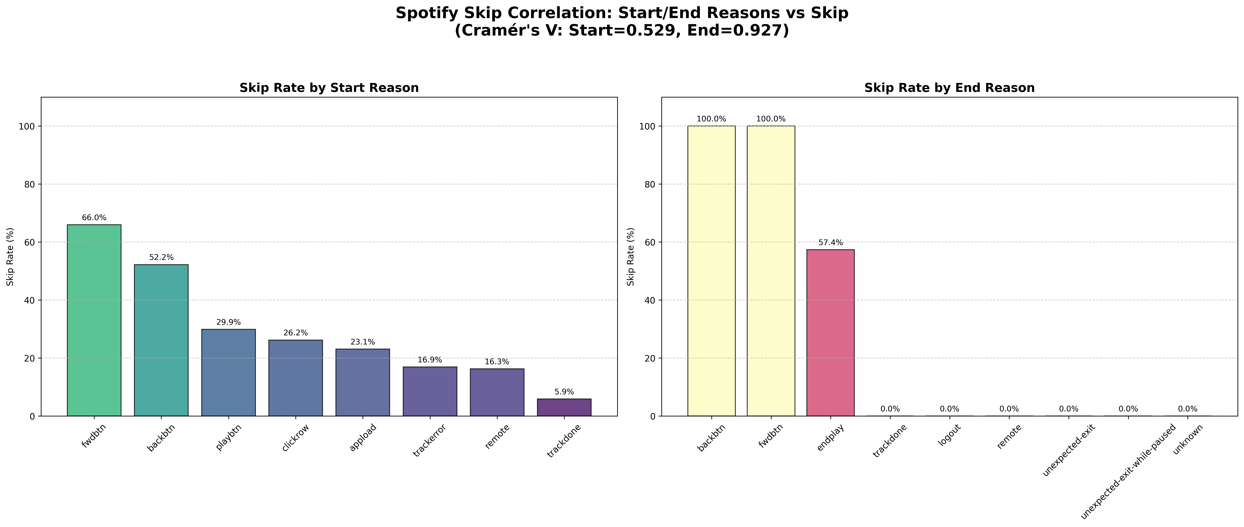
New Direction: Raw Streaming History Inputs

Slide 7
New Direction: Raw Streaming History Inputs
Reason Start | Amount in Data | Inferred Meaning | Possible Behaviour | Why
trackdone | 110176 | The previous track played to its end and this was the next track to play | Receptive | passive continuation
fwdbtn | 14031 | The user pressed Next/Forward and this was the next track to play | Responsive | explicit corrective/navigation action
clickrow | 10247 | The user pressed a specific track in a list of tracks | Deliberate | specific choice action
playbtn | 3080 | The user pressed Play on a playlist or other list of tracks | Deliberate | specific choice action
appload | 1647 | Playback began when the app loaded | Receptive | passive continuation
remote | 988 | The track was startedon another device and then transferred to this device | ?
backbtn | 735 | The user pressed Back and this was the previous track to play | Responsive | explicit corrective/navigation action
trackerror | 201 | The playback of the previous track ran into some form of error, and this was the next track to play | ?
unknown | 36 | The reason why the user (or the app) started playing this track is unknown | ?
reconnect | 3 | Playback began after app reconnects to the internet | Receptive | passive continuation
autoplay | 0 | Spotify automatically selected the next track | Receptive | passive continuation
popup | 0 | The user clicked on a Spotify recommended track | Responsive | explicit corrective/navigation action
Notes:
RPubs - my_spotify_historical_data
Spotify Track Data Analysis Guide | PDF | Spotify | Mobile App
My Spotify Life in Review. Analyzing 9 years of Spotify listening… | by Dylan Kershaw | Medium
librespot-protocol 0.8.0 - Docs.rs
python -c "import pandas as pd, glob; files = glob.glob(r'explorations/code/data/**/Streaming_History_Audio*.json', recursive=True); df = pd.concat([pd.read_json(f) for f in files], ignore_index=True); print(df['reason_start'].value_counts(dropna=False))“

Slide 8
New Direction: Raw Streaming History Inputs
Reason End | Amount in Data | Inferred Meaning | Possible Behaviour | Why
trackdone | 110922 | The track played to its end | Receptive | passive continuation
fwdbtn | 13937 | The user pressed Next/Forward | Responsive | explicit corrective/navigation action
endplay | 9921 | The user started playing something else (by clicking a track or Play/Shuffle button or similar) | Responsive | explicit corrective/navigation action
unexpected-exit-while-paused | 3642 | The playback was paused, and at some point after that, the app was shut down either by the user,or by the operating system, or it crashed | ?
logout | 1112 | The app was shut down or the user logged out. | ?
backbtn | 725 | The user pressed Back | Responsive | explicit corrective/navigation action
remote | 485 | The track playback was moved to another device | ?
unexpected-exit | 307 | The app was shut down eitherby the user, or by the operating system, or it crashed | ?
unknown | 64 | The reason why the user (or the app) ended playing this track is unknown | ?
trackerror | 28 | The playback of this track ran into some form of error | ?
playbtn | 1 | The user pressed Play on a playlist or other list of tracks | Deliberate? | specific choice action
Notes:
RPubs - my_spotify_historical_data
Spotify Track Data Analysis Guide | PDF | Spotify | Mobile App
My Spotify Life in Review. Analyzing 9 years of Spotify listening… | by Dylan Kershaw | Medium
librespot-protocol 0.8.0 - Docs.rs
python -c "import pandas as pd, glob; files = glob.glob(r'explorations/code/data/**/Streaming_History_Audio*.json', recursive=True); df = pd.concat([pd.read_json(f) for f in files], ignore_index=True); print(df['reason_end'].value_counts(dropna=False))“

Slide 9
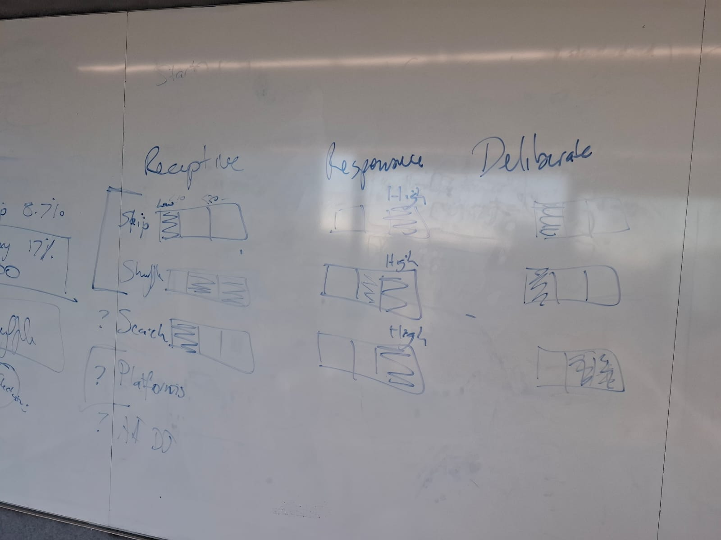
Courtesy of Amanda – First Algorithm
What is active selection?
successful_searches (interaction URI) + Reason_Start [‘clickrow’, ‘playbtn’]
What is skip rate? Skipped = True + Reason_End[‘fwdbtn’, ‘backbtn’, ‘endplay’]
What is shuffle rate? Shuffle = True
Behaviour set as Mixed If the signals are contradictory
Receptive
Logic:
Low Skip Rate + Low Active Selection.
Interpretation:
The user is “receptive” to whatever the algorithm or playlist provides.
They aren't choosing songs manually, but they aren't skipping them either.
Responsive
Logic:
High Skip Rate + Medium/High Shuffle Rate
Interpretation:
The user is actively seeking a specific "vibe" but unsure of the track.
They are “responding” to songs they don't like by skipping or reshuffling.
Deliberate
Logic:
High Active Selection + Low Friction (Low skips/shuffles)
Interpretation:
The user knows exactly what they want to hear.
They search for it, play it, and let it finish.

Slide 10
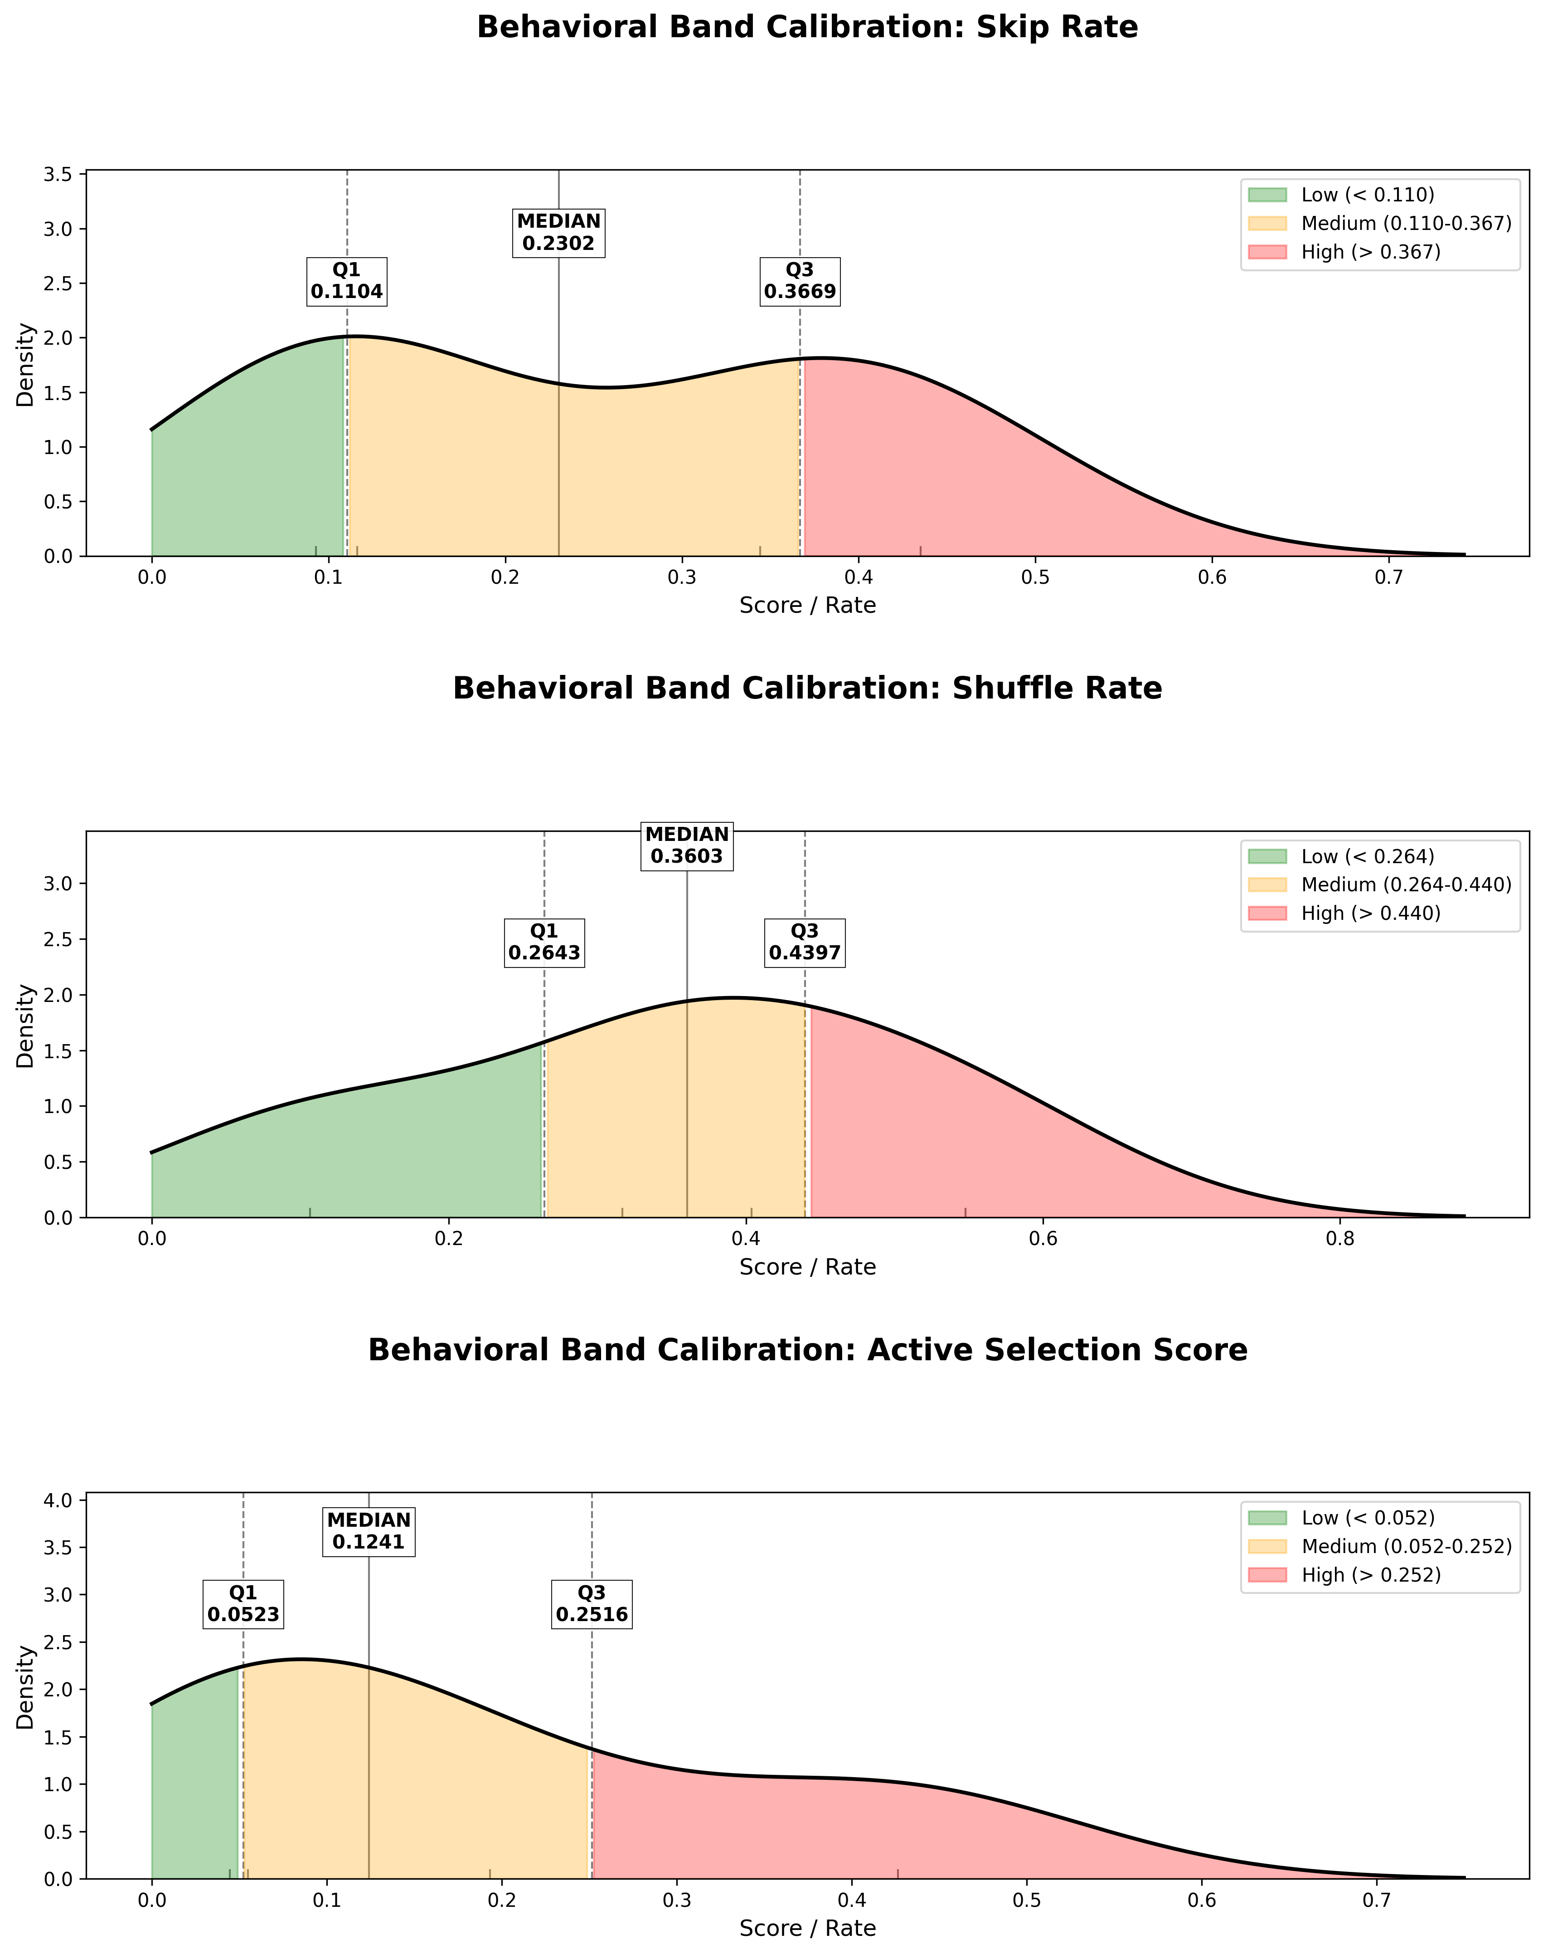
Courtesy of Amanda – First Algorithm
How to determine Low Medium High?
Quartiles, cohort-based
Minimum 100 streams (4 out of 5 user data)
See Kernel Density Estimate (KDE) plots

Slide 11
Supporting signal: Start/End Dominant Types
Fallback explanatory proxies, user-based
Strict 60% threshold (otherwise “Mixed”)
Most likely biased towards Passive and Natural
Start Dominant Type
Manual Start Heavy
clickrow, playbtn
Passive Continuation Heavy
trackdone
End Dominant Type
Skip Heavy
fwdbtn, backbtn, or endplay
Natural Completion Heavy
trackdone

Slide 12
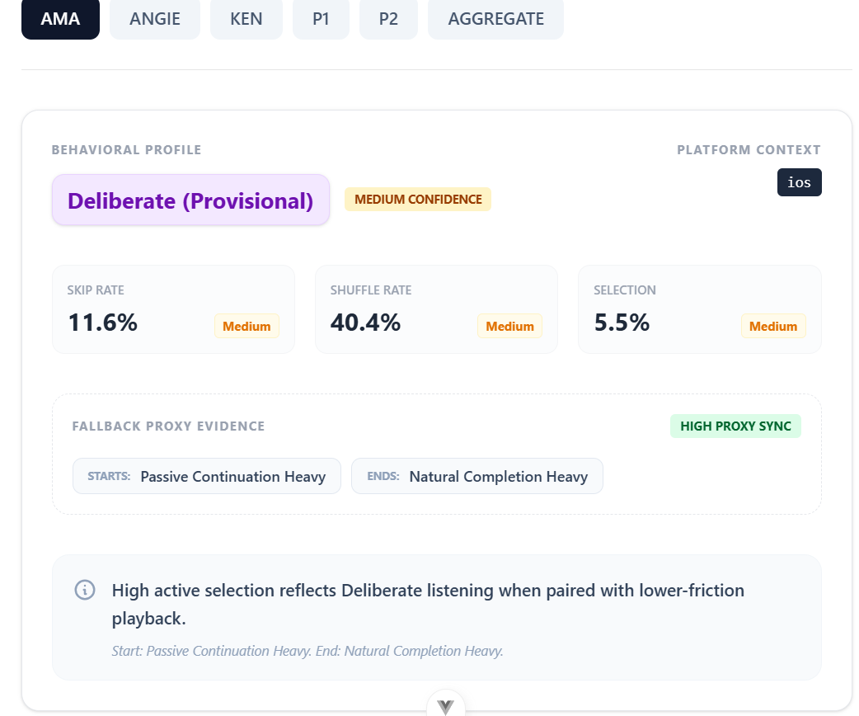
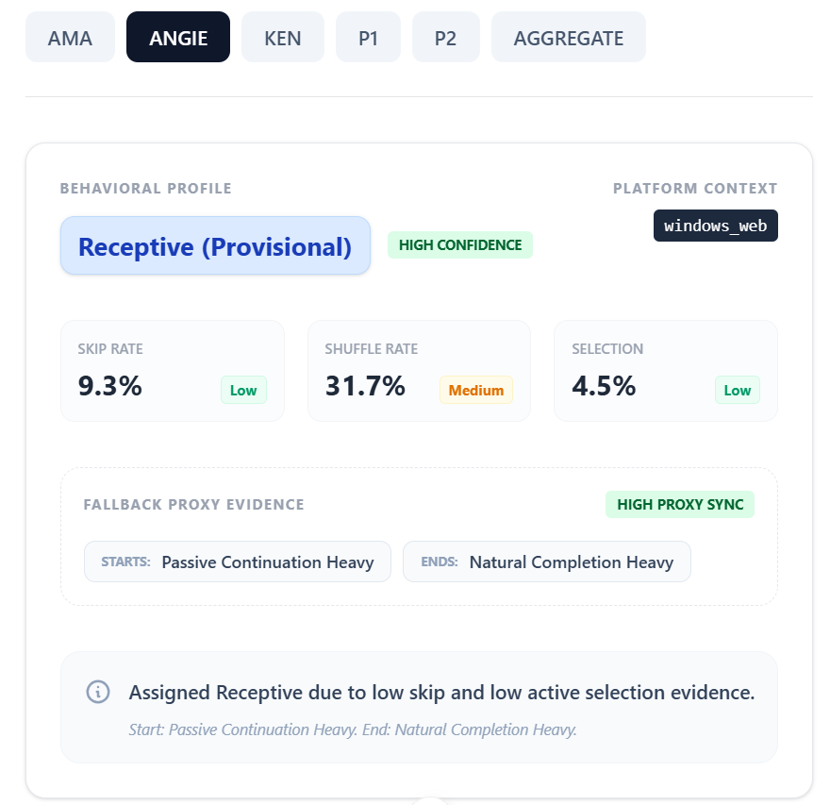

Slide 13
Possible Future Plan
Consider Temporal Way of mapping this (modify current temporal dashboard from emotion -> behaviour profiles)
Time of Day and Geospatial part of it
Research more on platforms (ios, android, etc) vs the tendencies of people when listening to music?
How to make sure students want to donate other parts of their spotify data besides the streaming history files?

Slide 14
Thank you!

